Slide 1
Improved Geometric Veriﬁcation for Large Scale Landmark Image Collections
Rahul Raguram, Joseph Tighe, and Jan-Michael Fram
Department of Computer Science
University of North Carolina at Chapel Hill

Slide 2

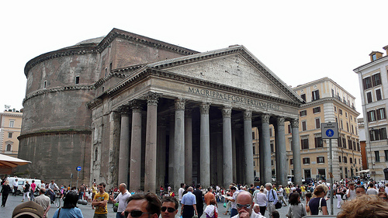
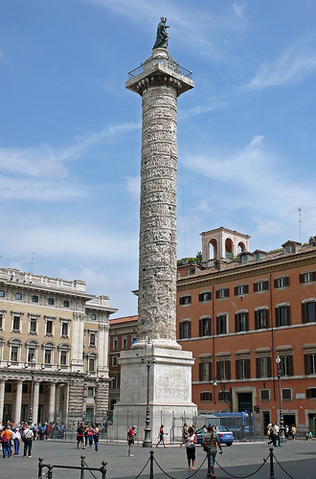
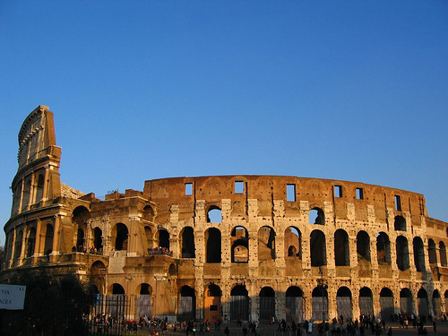
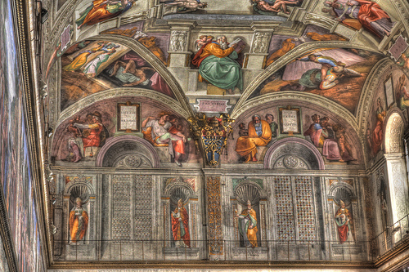
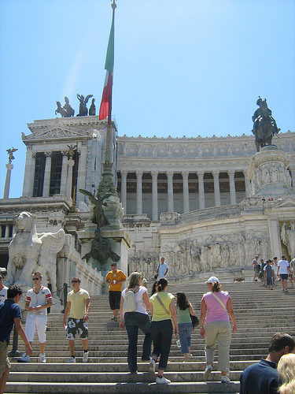
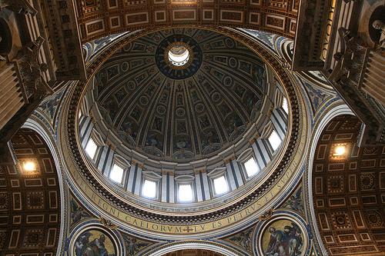
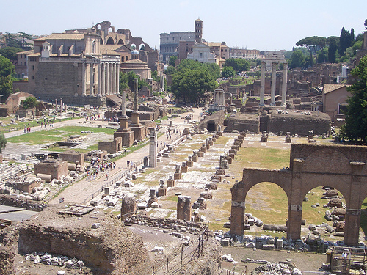
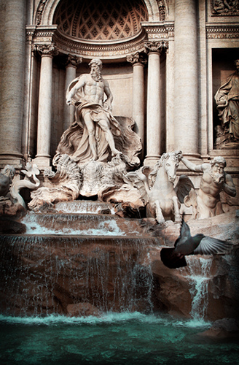
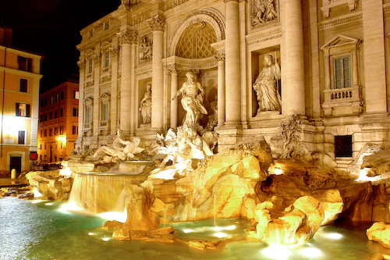
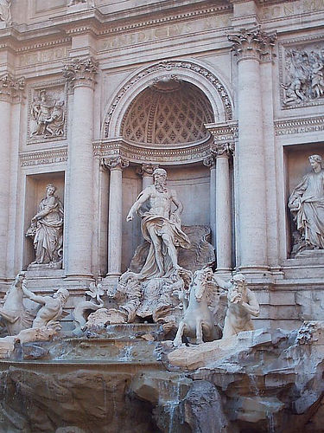
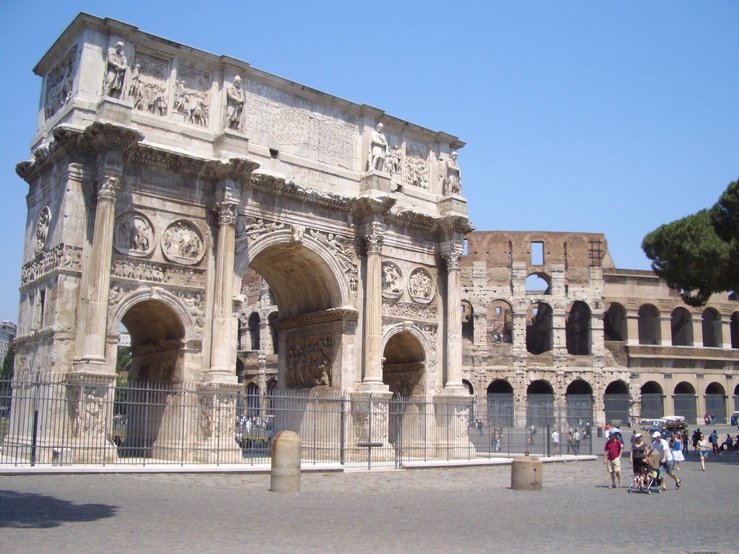
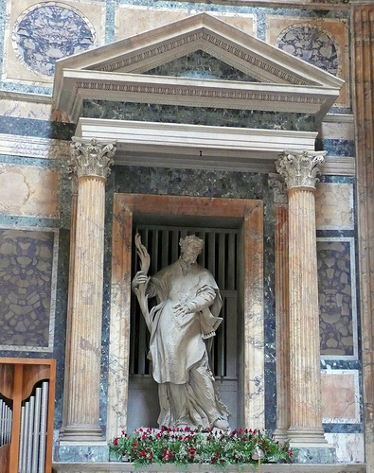
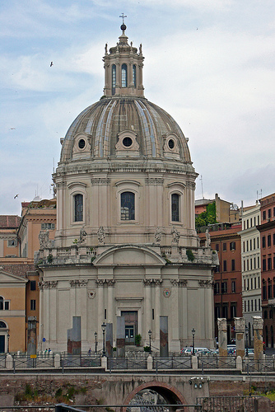
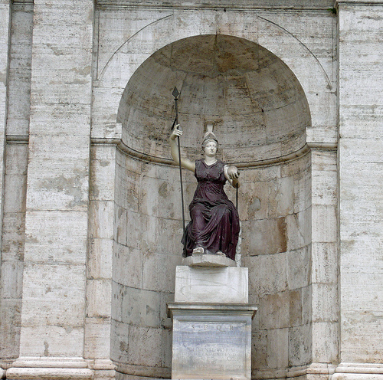
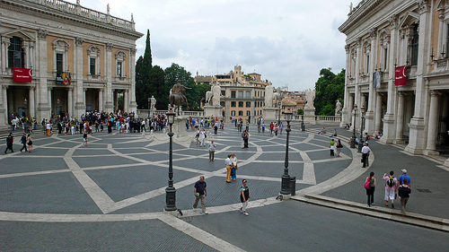
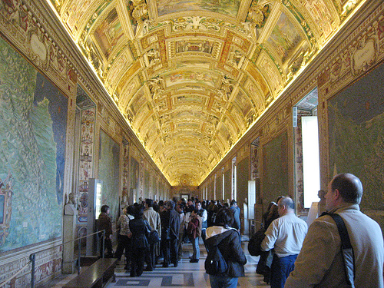
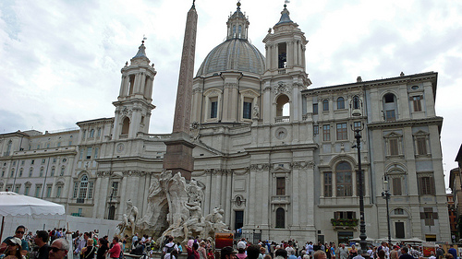

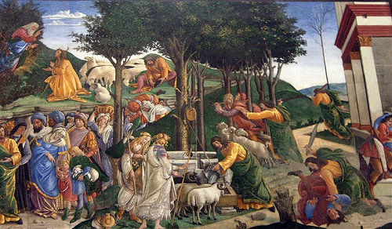
Images of Rome

Slide 3
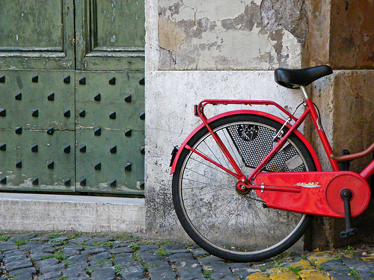
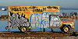

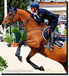


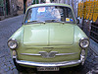
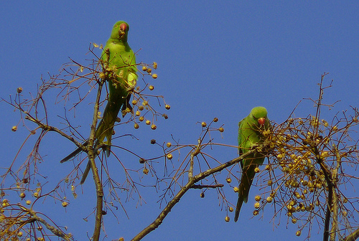
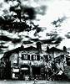


Slide 4
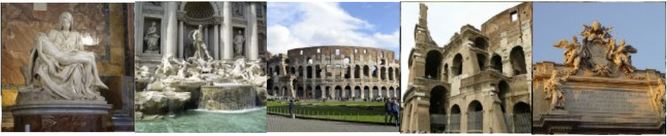
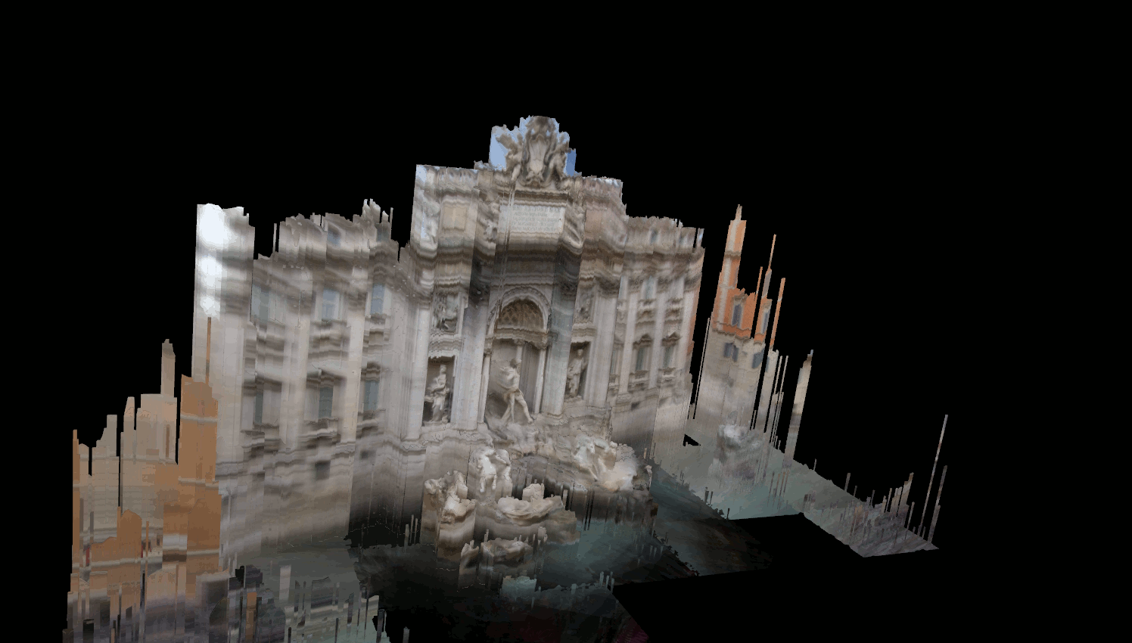
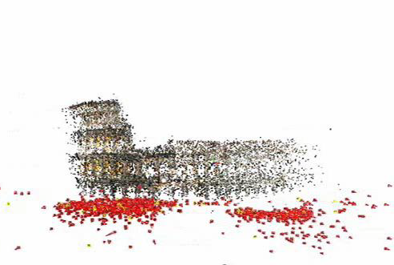
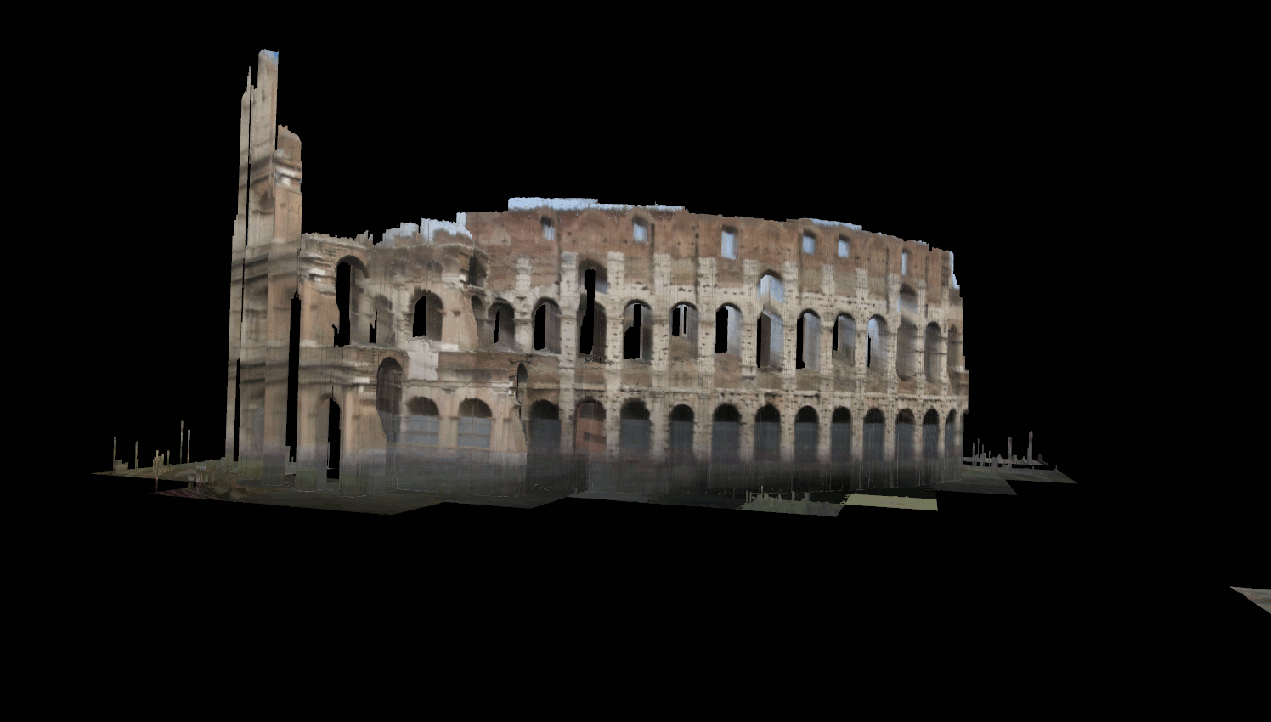
Photo Collection Modeling
3 million
150K
Photo Tourism
3K
46K
3K
2006
24 PCs
2 weeks
[Snavely’ 06]
2008
24 PCs
36 hrs
[Snavely’ 08]
2008
1 PC
24 hrs
[our work ‘08]
2009
64 PCs
24 hrs
[Argawal ’09]
2010
1 PC
24 hrs
[Frahm ’10]
None nearly addresses all challenges!
Notes:
Half of the 24 hours is geometric verification

Slide 5
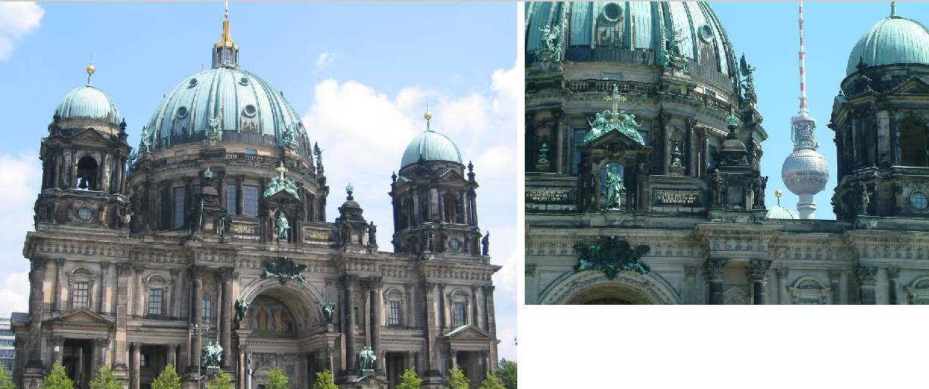
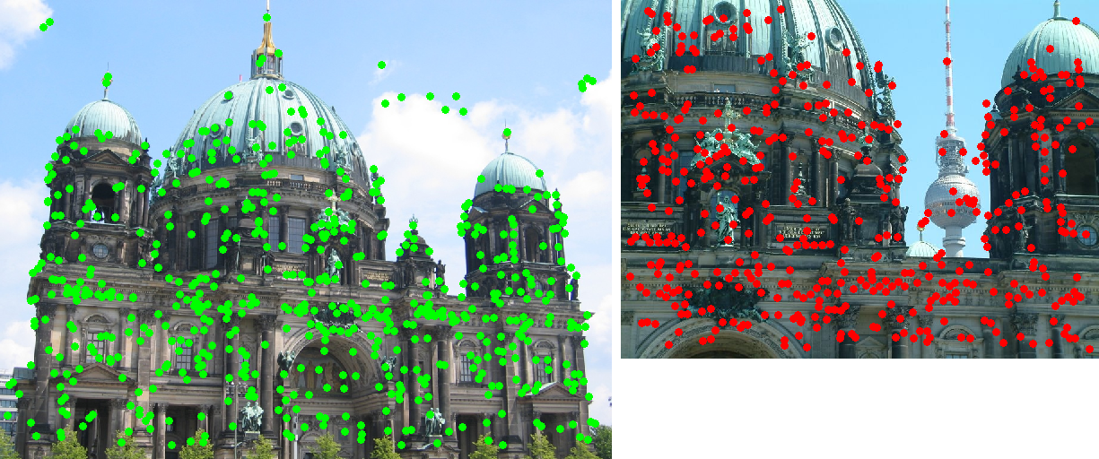
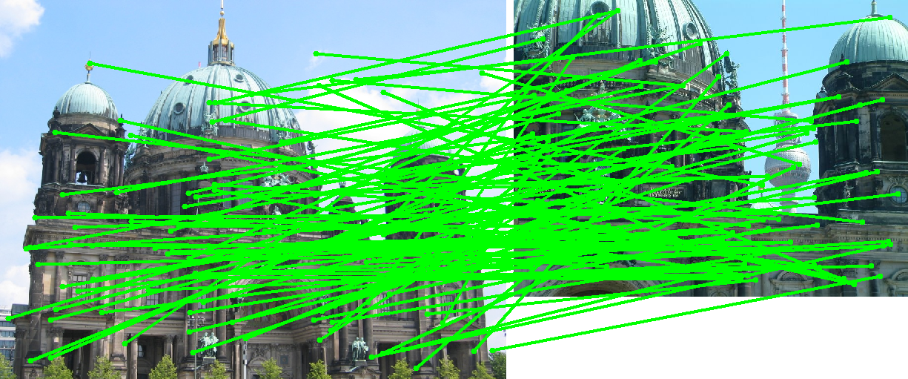
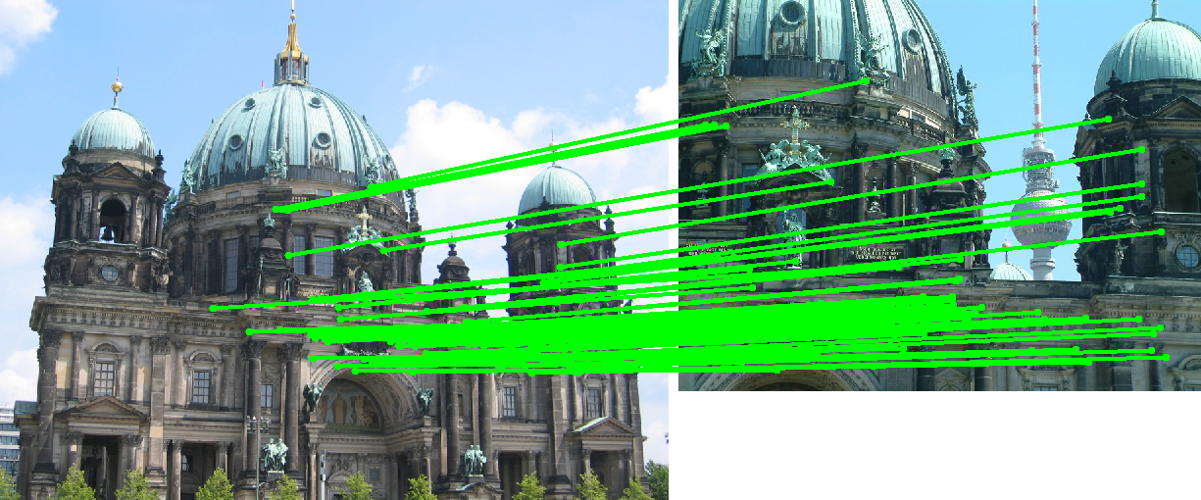
Geometric verification
For a pair of images:
Detect feature points
Match features
Run RANSAC to find inliers
Notes:
Fundament matrix
7 point

Slide 6
RANSAC Advances
Many improvements to RANSAC
Preemptive RANSAC (Nister)
Breadth first search
WALDSAC (Chum and Matas)
Sequential decision theory
Real-time ARRSAC (Raguram et al.)
Combines preemptive RANSAC and WALDSAC
PROSAC (Chum and Matas)
Priority ordering
Notes:
Sift match ratio
----- Meeting Notes (8/31/12 16:10) -----
LORANSAC

Slide 7

PROSAC
Exploit image-to-image matching scores
Order matches based on matching scores
Sample from a small subset of the best points, gradually extend the size of the sampling pool

Slide 8
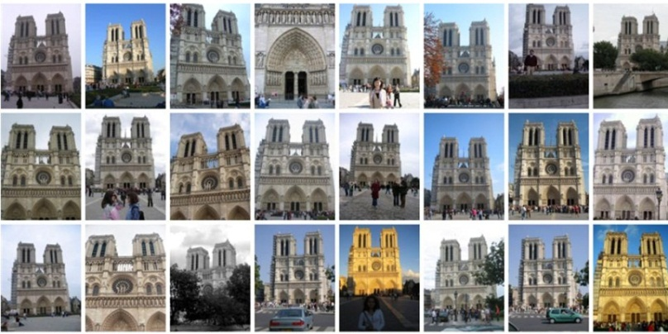
Motivation
Thus far, only image-to-image matching information has been considered
PROSAC only requires a priority ordering on matches
Key Insight: We can learn a better ordering metric from previous matches.
Notes:
Say in photo collections we match 10k times

Slide 9
Adaptive Feature Prioritization
Consider a visual vocabulary W = {w_{1,} w₂, …, w_{N}}
Obtained by running k-means on a random subset of points
Carry out standard geometric verification:
For a pair of images: match features, run ARRSAC
If verified: update counts c_{i} for each visual word w_{i} that was found to be an inlier
Idea: counts C = {c_{i}} can be used as a learned priority order for PROSAC like sampling
Set the sample priority order to the ordering from these counts
Notes:
explain visaul vocabulary
at 500 correct matches this starts to improve things

Slide 10
Adaptive Feature Prioritization
Count
Visual Word
Evolving single feature inlier counts
Notes:
----- Meeting Notes (8/27/12 13:24) -----
unordered list of visual words under access

Slide 11
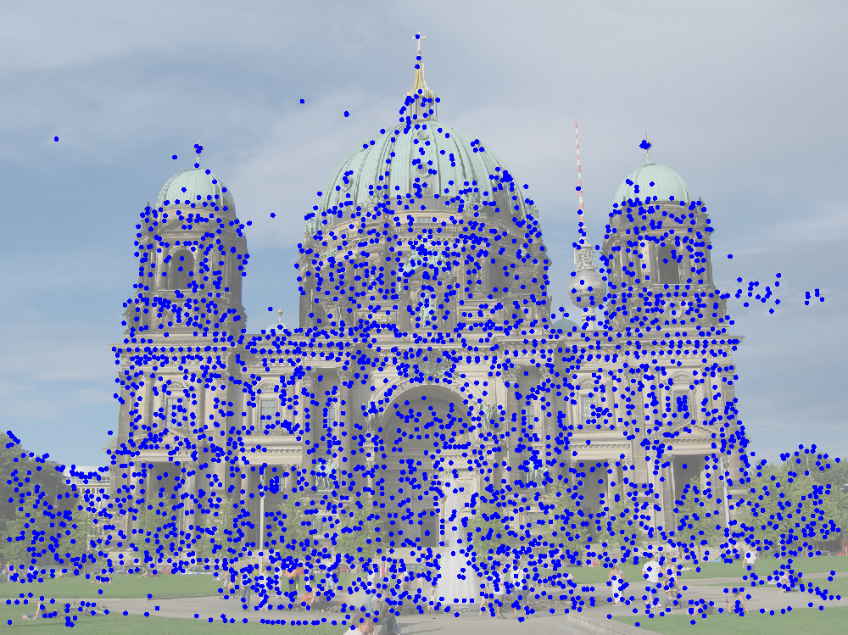
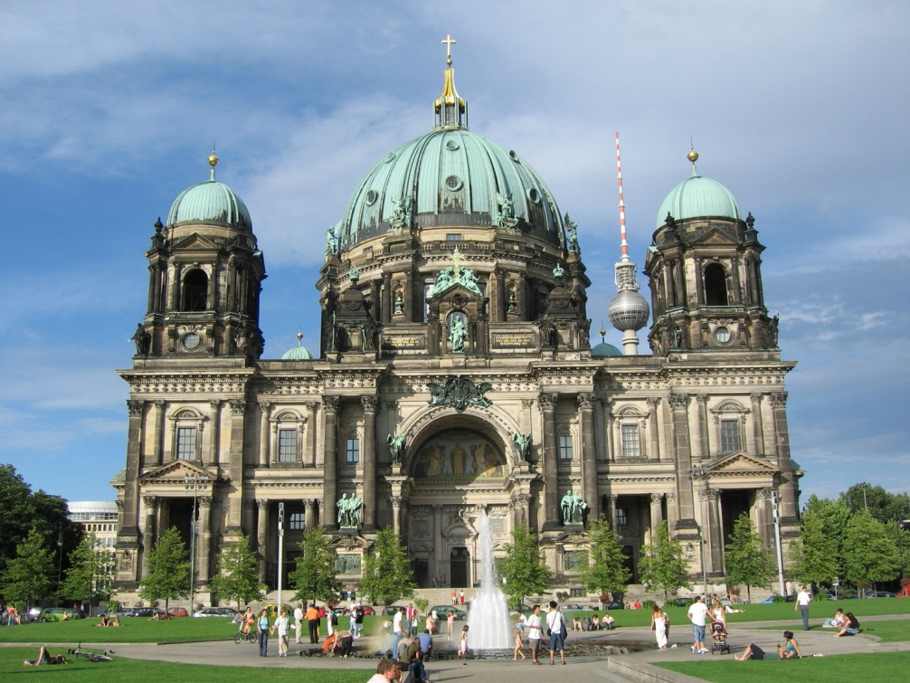
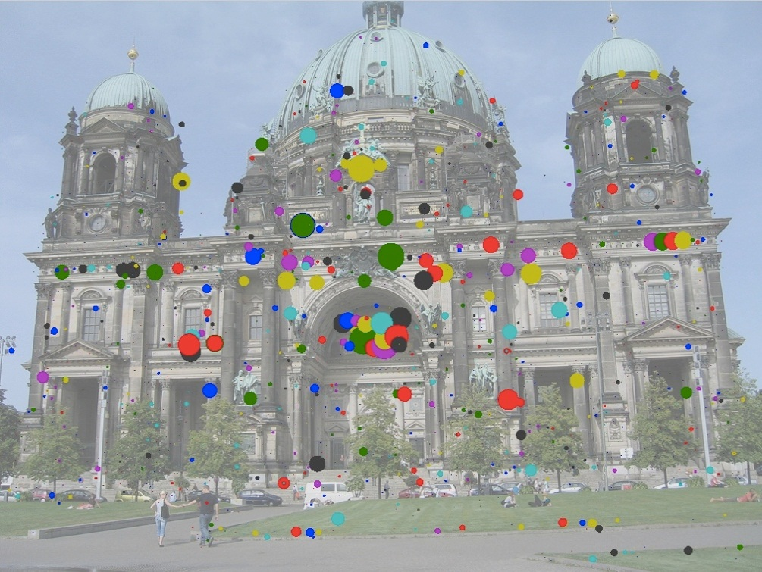
Experiments: Berlin Dome (10k)
Dataset:
10k images for the Flickr query ‘Berlin Dome’
Relatively clean, with most images showing the Dome
Randomly choose k image pairs and carry out geometric verification
Accumulate counts for visual vocabulary (20k words)
All detected sift features
Filtered features based on visual word counts (c_{i} > 10)
Notes:
Don’t say color coded they can’t see it
~400k image pairs were compared

Slide 12
Experiments: Berlin Dome (10k)
Experiment: Compare
R1: baseline RANSAC
R2: ARRSAC with ordering based on SIFT matching scores
R3: ARRSAC with proposed ordering
Observation: Sorting visual words based on results of previously rounds of geometric verification reveals useful information about the validity of feature matches
 | R1 | R2 | R3
Mean time per image pair | 389.6 ms | 41.2 ms | 28.9 ms
Mean # of hypotheses per image pair | 14218.4 | 604.1 | 399.7
Total runtime (hours:minutes) | 23:48 | 04:08 | 03:16
Notes:
Note that there is no dedicated “training” phase for R3.
Initially, we start with all visual word priorities set to zero, and then progressively accumulate inlier counts.
As the matching progresses, the efficiency of R3 increases rapidly.
Empirically after 500 pairs of images are verified it becomes more efficient than the matching score based ordering
And after 1000 its near optimal

Slide 13
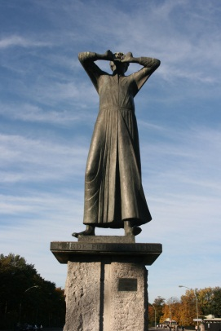
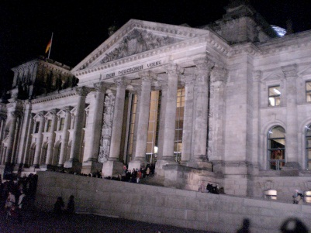
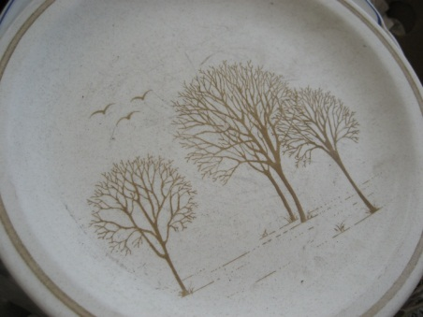
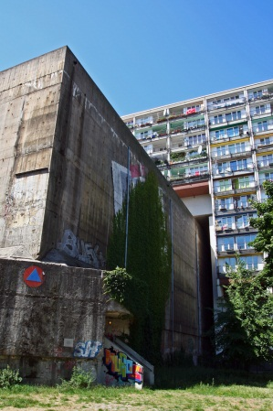
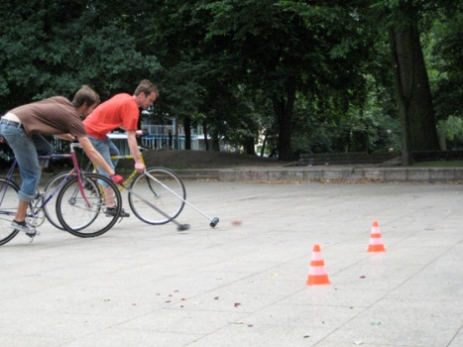
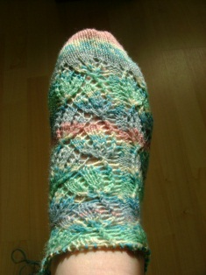
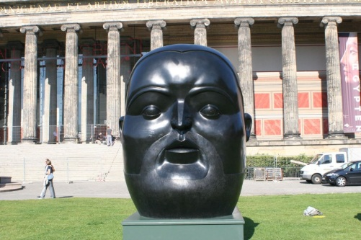

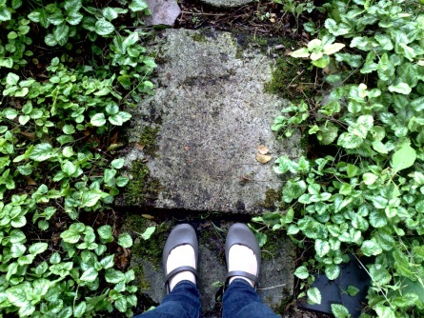
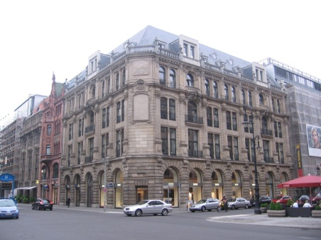
Experiments: Berlin (2.77M)
Dataset:
2.77 Million images for the Flickr queries
Very noisy
Use “Building Rome on a Cloudless Day” (Frahm et al.):
Cluster images into 100,000 clusters
Perform geometric verification on each cluster independently
Clusters with 3 or more verified images are kept as iconic
All unverified images are discarded
Accumulate counts for visual vocabulary (1 million words)

Slide 14
Experiments: Berlin (2.77M)
Experiment: Compare
R2: ARRSAC with ordering based on SIFT matching scores
R3: ARRSAC with proposed ordering
Only 5% of the entire dataset has been registered
 | R2 | R3
Mean time per image pair | 26.7 ms | 18.8 ms
Total runtime (hours:minutes) | 02:50 | 02:28
# of Iconics | 9841 | 9912
# of Registered Images | 132,719 | 133,830
Notes:
Could be an effect of the noise

Slide 15
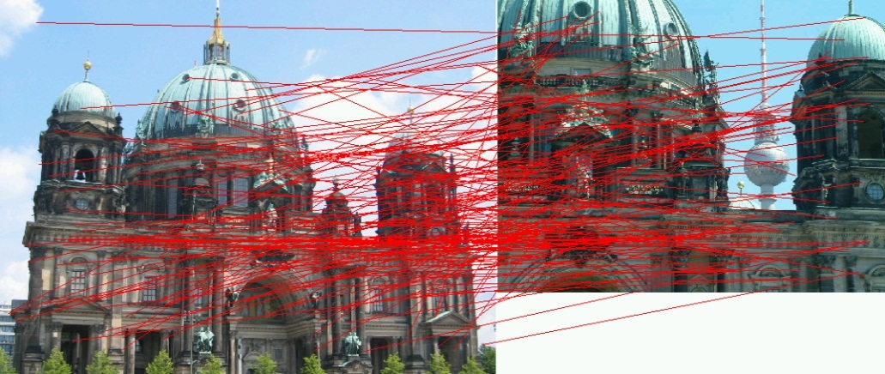
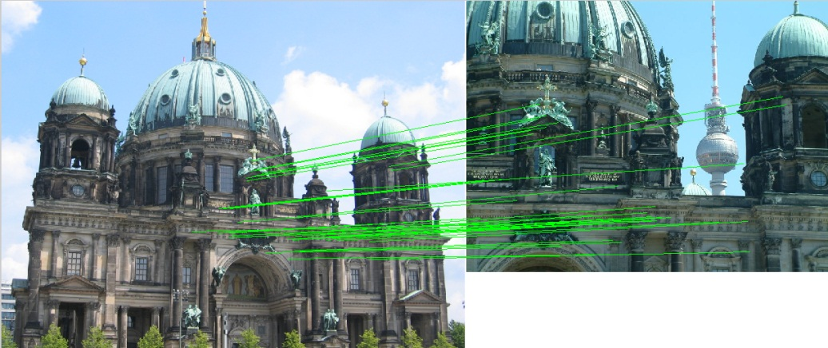
Experiments: Berlin (2.77M)
Putative matches
Inliers (ε ≈ 0.20)
 | RANSAC | ARRSAC w/ match scores | ARRSAC w/ inlier counts
# of hypotheses | 1.07x10⁶ | 22000 | 595
Run time | 2.77x10⁴ ms | 818.3 ms | 27.5 ms
Notes:
Generated mid way after 500 images

Slide 16
Addressing Completeness
We wish to register the 2.64 million image that were not registered in the first step
For each rejected image:
Retrieve the 20 most visually similar iconic images
Perform geometric verification
This process alone takes 1 day, 10 hours. This is too slow.
Key Insight: We can learn what a “good” image looks like.
Notes:
Make key insight popout

Slide 17
Addressing Completeness
Train a “landmark” image classifier from the iconic images already found.
Positive examples: the iconic image from each cluster (9,471 images)
Negative examples: random set of rejected images (10,529 images)
Use our dictionary to compute a bag-of-visual-words histogram
While this feature has 1 million dimensions, note it is very sparse with on average only 2,000 words
Train a linear SVM
Notes:
At test time, the classifier evaluation is a sparse inner product which, for our problem, amounts to on average 2;000 addition operations

Slide 18
Experiments: Berlin (2.77M)
Verify only rejected images that are classified as “landmarks”
26% of rejected images are classified as “landmarks”
 | Full re-verification | SVM+re-verification
# of newly registered images | 273,639 | 202,538
Total runtime (days:hours:minutes) | 01:10:26 | 00:10:43

Slide 19
Summary
Combining recognition and geometry methodologies enables fast, more complete registration.
Learned priors based on match history:
Captures useful information about the low-level features which are useful for the specific task of interest (geometric verification)
Using a fast pre-classification step can greatly decrease runtime while minimally impacting matching performance.

